Slide 1
Announcements
📝Hw0 (Setup): weblab.is/hw0
Need to set up MongoDB by Thursday
📗 Panopto livestream is working now! weblab.is/livestream (and we still have weblab.is/zoom )
🧠No office hours today
🪧Milestone 0 (find a team and brainstorm 10 ideas) due eod Wednesday
💛Still need a team? Check out the team finding piazza post
🎦Recordings from today will be available as soon as we edit + post them (hopefully this evening). Slides are all available at weblab.is/schedule and weblab.is/slides

Slide 2
JS Cont: Callback Functions and Arrays
Abby Chou

Slide 3
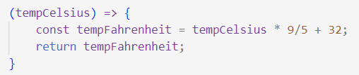
=>
{ const tempFahrenheit = tempCelsius * 9/5 + 32;
return tempFahrenheit; };
(tempCelsius)
Notes:
What this code, as written, is doing, is it’s allotting a space in memory for this function, and then it’s storing the function in memory. So somewhere in memory we’ve recorded the ability to take in an integer temperature, and do this calculation and return the result. But in order to actually use this function, there’s something we’re missing.

Slide 4
=>
{ const tempFahrenheit = tempCelsius * 9/5 + 32;
return tempFahrenheit; };
celsiusToFahrenheit
(tempCelsius)
Notes:
We need to give it a name! We need a name that points to the location in memory where we stored the function. So let’s call it celsius to Fahrenheit.

Slide 5
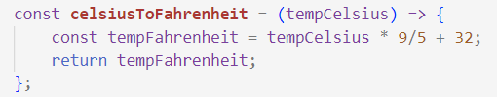
=>
{ const tempFahrenheit = tempCelsius * 9/5 + 32;
return tempFahrenheit; };
celsiusToFahrenheit
(tempCelsius)
Notes:
And in JS, we do this by assigning the function to a variable. Notice that the syntax here is exactly the same as any other variable: we have const, which means we’re not going to change what this variable points to, then the variable name, then the equals sign. Then we have the value that we want the variable to point to, which in this case is our function, and then a semicolon. So it’s just a variable.

Slide 6
=>
{ const tempFahrenheit = tempCelsius * 9/5 + 32;
return tempFahrenheit; };
celsiusToFahrenheit
(tempCelsius)
Notes:
And in JS, we do this by assigning the function to a variable. Notice that the syntax here is exactly the same as any other variable: we have const, which means we’re not going to change what this variable points to, then the variable name, then the equals sign. Then we have the value that we want the variable to point to, which in this case is our function, and then a semicolon. So it’s just a variable.

Slide 7
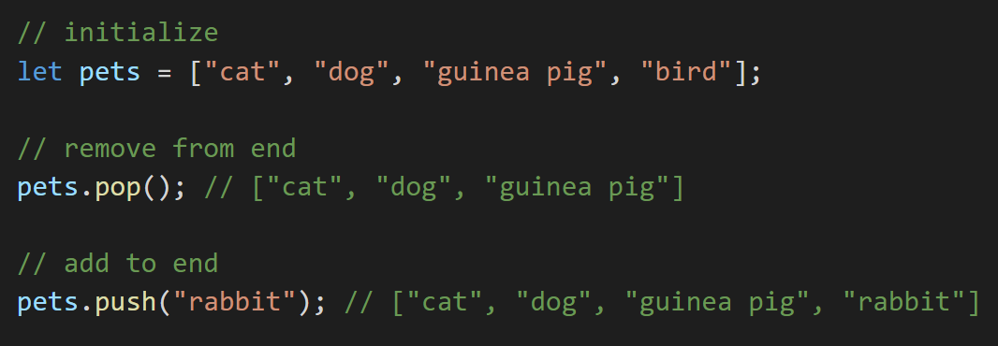
Review: Push and Pop
Notes:
Can initialize an empty array by just not putting anything inside the brackets!

Slide 8
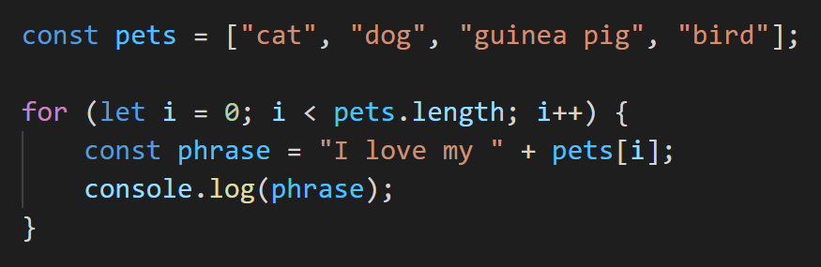
Review: Looping Through an Array

Slide 9
Practice!
Write a function that takes in an array of temperatures (in Celsius) and outputs an array with all the temperatures converted to Fahrenheit.
DO NOT mutate (change) the input array!
Paste your code into the browser console (or write it directly there) to test.
tempF = tempC * 9/5 + 32
Notes:
3 min, maybe 4 if ppl need more time

Slide 10
Adding more…
Let’s say we now want three functions:
Converting an array of Celsius temps to Fahrenheit (what we just did)
Converting an array of Fahrenheit temps to Celsius
Converting an array of Celsius temps to Kelvin
Notes:
The monkey way of doing this is to copy and paste this function 2 more times, and just change this one highlighted part.

Slide 11
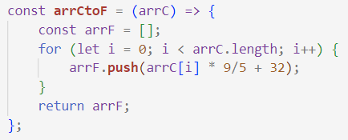
Adding more…
Let’s say we now want three functions:
Converting an array of Celsius temps to Fahrenheit (what we just did)
Converting an array of Fahrenheit temps to Celsius
Converting an array of Celsius temps to Kelvin
Notes:
The monkey way of doing this is to copy and paste this function 2 more times, and just change this one highlighted part.

Slide 12
We want to reuse all this code *except* the the part highlighted in orange.
Notes:
But copying and pasting is bad! So somehow we want to take everything outside the orange highlight, all the code that creates a new array, and pull it out into a general function that we can reuse.

Slide 13

Callback functions to the rescue!
Callback functions

Slide 14
Using Callbacks
Step 1: Write a general modifyArray function that takes in 2 inputs: an array and a callback function, and returns a new array, the result of applying the callback function to each element of the original.

Slide 15
const modifyArray = (arr, transformFunc) => {
// apply transformFunc to all elements of arr, return
// the result
};

Slide 16




const modifyArray = (arr, transformFunc) => {
// apply transformFunc to all elements of arr, return
// the result
};
modifyArray( , );
[
]
cat
,
,
,
hattify
cat with hat
Notes:
Let’s give an example of calling this modifyArray function!

Slide 17

const modifyArray = (arr, transformFunc) => {
// apply transformFunc to all elements of arr, return
// the result
};
modifyArray( , );
[
]
cat
,
,
,
hattify
cat with hat
hattify
[
]
Notes:
Let’s give an example of calling this modifyArray function!

Slide 18

const modifyArray = (arr, transformFunc) => {
// apply transformFunc to all elements of arr, return
// the result
};
modifyArray( , );
[
]
cat
,
,
,
hattify
cat with hat
hattify
[
]
,
Notes:
Let’s give an example of calling this modifyArray function!

Slide 19

const modifyArray = (arr, transformFunc) => {
// apply transformFunc to all elements of arr, return
// the result
};
modifyArray( , );
[
]
cat
,
,
,
hattify
cat with hat
hattify
[
]
,
,
Notes:
Let’s give an example of calling this modifyArray function!

Slide 20
const modifyArray = (arr, transformFunc) => {
// apply transformFunc to all elements of arr, return
// the result
};
modifyArray( , );
[
]
cat
,
,
,
hattify
cat with hat
hattify
[
]
,
,
,
Notes:
Let’s give an example of calling this modifyArray function!

Slide 21
const modifyArray = (arr, transformFunc) => {
// apply transformFunc to all elements of arr, return
// the result
};
modifyArray( , );
[
]
cat
,
,
,
hattify
cat with hat
[
]
,
,
,
Notes:
Let’s give an example of calling this modifyArray function!

Slide 22
Let’s generalize :D
Step 1: Write a general modifyArray function that takes in 2 inputs: an array and a callback function, and returns a new array, the result of applying the callback function to each element of the original.
Step 2: Use your modifyArray function to do the following:
Convert an array of Celsius temps to Fahrenheit (what we just did)
Convert an array of Fahrenheit temps to Celsius
tempC = (tempF - 32) * 5/9
Convert an array of Celsius temps to Kelvin
tempK = tempC + 273.15

Slide 23
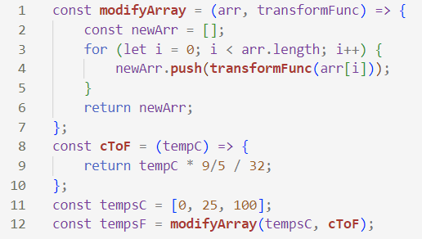
Solution

Slide 24
Solution

Slide 25
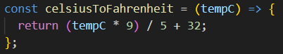
Side Note: Shortened Function Notation
This is just a shortened way of writing this!
2 ways of writing functions:
(inputs) => { do stuff (and optionally return an output) }
(inputs) => (output)

Slide 26
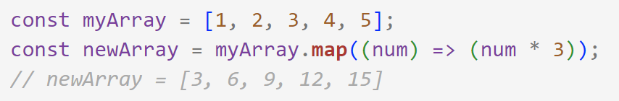
map(...)
Creates a new array by applying the callback function to every element of the starting array.
Notes:
Only difference from modifyArray is that in modifyArray we took the array as a parameter, but now we do the array, dot, map, and then the only parameter is the callback function.

Slide 27
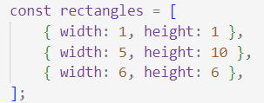
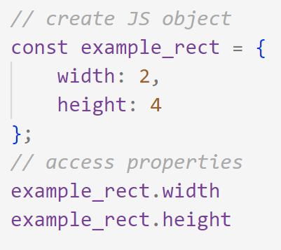
Map Practice
This is an array of JavaScript objects!
Copy this array into your JS file, then use map to create an array of the areas of the rectangles.
Map example:
Objects example:

Slide 28
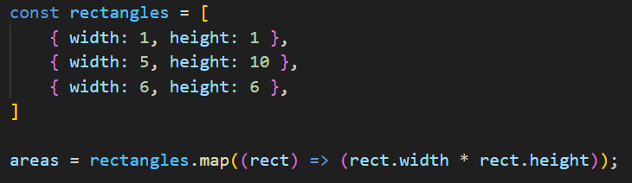
Solution

Slide 29
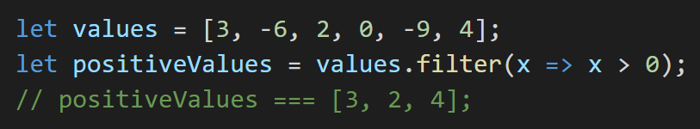
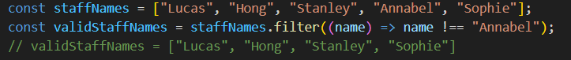
filter(...)
Creates a new array by selecting the elements in the starting array which pass the given “test” (i.e. filtering out the “bad” elements and keeping the “good” ones).
Notes:
Two examples again.

Slide 30
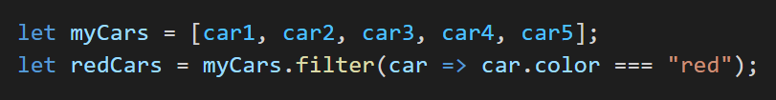
Filter Practice
Using the rectangles array from earlier, use filter to create an array that only contains rectangles with perimeter > 10.
Example:

Slide 31
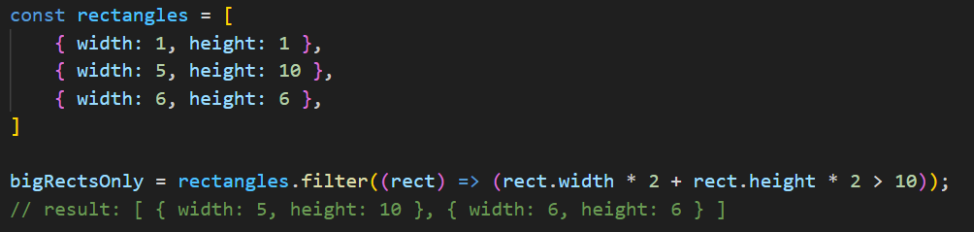
Solution

Slide 32
Why do we use callback functions?
Reusability (map and filter)
So we don’t have to write code to loop through an array over and over.
Abstraction
“When x happens, do this”
And let other smart ppl (the writers of JavaScript libraries) write the code for this!
We can write the code for this…
Notes:
What do I mean by this? Let’s look at a few examples.

Slide 33
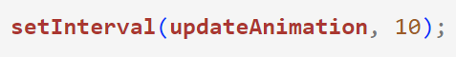
Callback Functions in Web Dev
Let’s say we wrote a function, updateAnimation(), that we want to call every 10 milliseconds.
Writing code to manage timers is annoying, so the JavaScript authors did it for us!
“When the timer goes off, call updateAnimation”
Notes:
It’s like saying to setInterval (and the JS library code behind it), “hey, when the timer goes off, could you call updateAnimation for me?”

Slide 34
Callback Functions in Web Dev
Snake Workshop: Responding to keyboard inputs!
Notes:
In the workshop, we wrote this function to change the snake’s direction based on an arrow key press. But we don’t want to have to write a ton of code that connects to the browser window to listen for events (i.e. the user doing stuff), and when one occurs, checks to see if it was a key being pressed, a key being unpressed, the mouse being clicked, the mouse being dragged, etc.

Slide 35
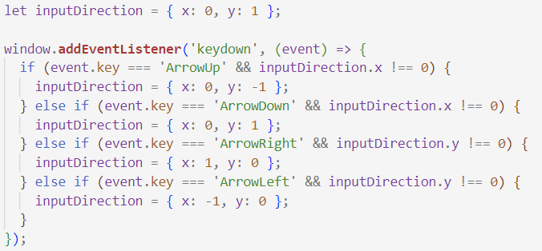
Callback Functions in Web Dev
Snake Workshop: Responding to keyboard inputs!
“When you get a keypress, do this with it”
Notes:
It’s like we’re saying to the JavaScript library event listener, “Hey, when you get a keypress, I need you to do this with it!” The “this” being all the logic inside our callback function, and the “it” being the event object which represents the type of keypress it was.

Slide 36
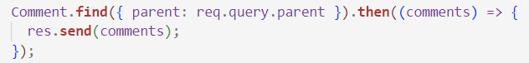
Callback Functions in Web Dev
Later: Database query returns a promise, and we want to do something when that promise resolves (i.e. when the database gives us the info we need)

Slide 37
Callback Functions in Web Dev
Later: Database query returns a promise, and we want to do something when that promise resolves (i.e. when the database gives us the info we need)

Slide 38
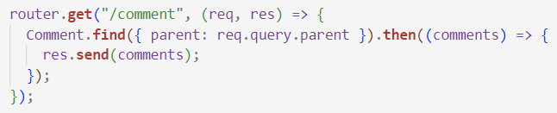
Callback Functions in Web Dev
When we receive an http GET request to the /comment endpoint, we want to send a response with the comments we got from the database.

Slide 39
Callback Functions in Web Dev
When we receive an http GET request to the /comment endpoint, we want to send a response with the comments we got from the database.

Slide 40
Feedback Time!
weblab.is/feedback

